Slide 1
Disposal of records in Iceland
Status report
Árni Jóhannsson

Slide 2
Agenda
Regulatory framework for appraisal and disposal of archives in Iceland
The process of appraisal and disposal at the National Archives
Appraisal and disposal statistics since 2010
The future, more rules = fewer disposal requests

Slide 3
regulatory framework for appraisal and disposition of archives in Iceland
Enactment of the National Archives of Iceland of 1985
The board of NAIS responsible for the final decision on disposal of records
Prohibited to destroy or dispose of any records in the archives of public agents
Special rules for disposal

Slide 4
regulatory framework for appraisal and disposition of archives in Iceland
Accounting act
The law on privacy
The enactment of the National Archives higher in the hierarchy regarding disposal of records
Necessary to request the disposal of records
Special rules for municipalities

Slide 5
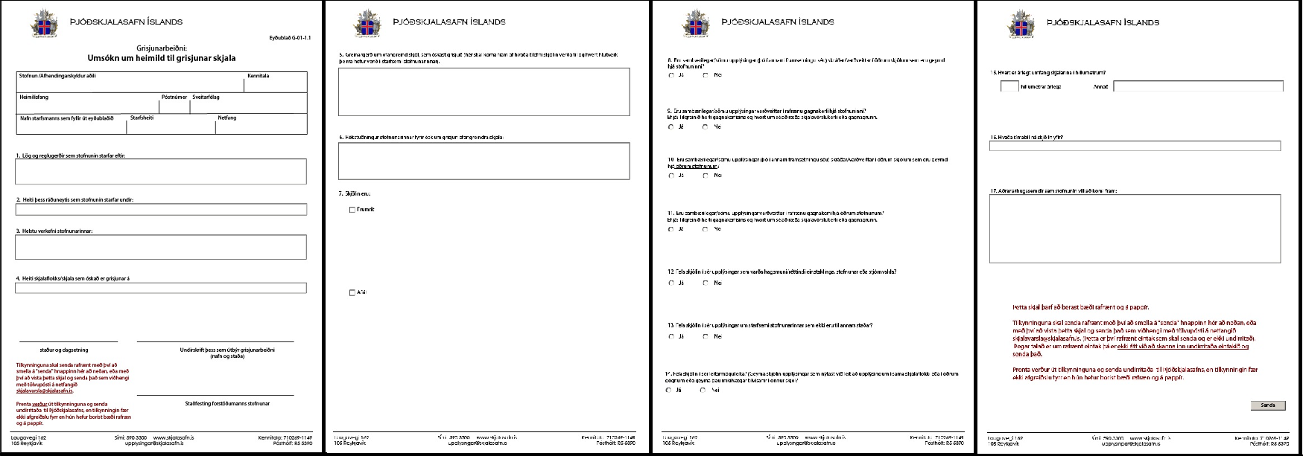
The process of appraisal and diposition at the National Archives

Slide 6
The process of appraisal and diposition

Slide 7
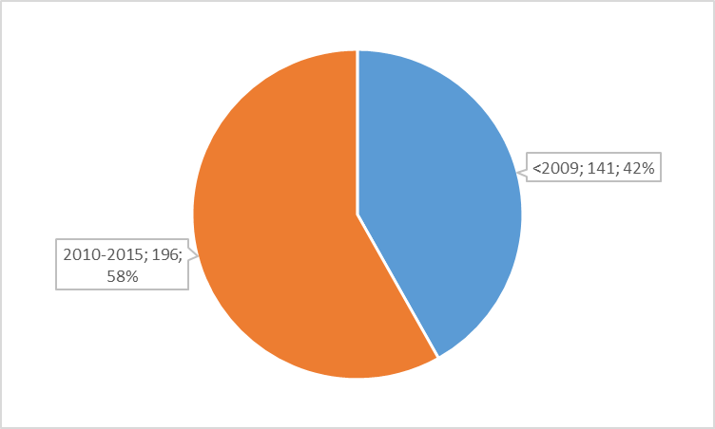
Disposal requests

Slide 8
Disposal requests – accepted/rejected

Slide 9
The future, more rules = fewer disposal requests
Vision for the future, rules regarding disposal of records
Database called The Middle
Supporting documents for accounting, 48% of disposal requests
Schools, examination papers
Work documents
You never dispose records made before 1960
Registers, case files

